Slide 1
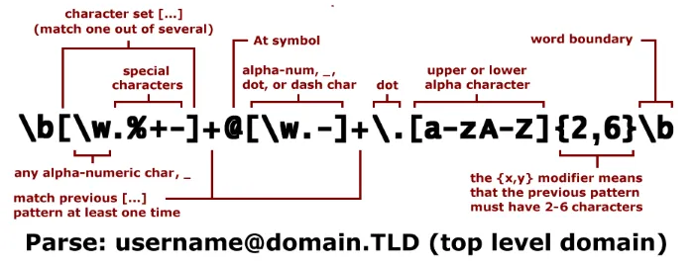
Regular Expressions (ReGex)
Find your (string) match ❤️

Slide 2
What is ReGex?
Sequence of characters that define search patterns
These patterns can be used for matching and managing text
Very useful for format validation
ReGex is used many production code bases
Built in support by most major languages

Slide 3
Anchors - ^ and $
^ - match beginning of the line
$ - match ending of the line
// matches any string starting with “Hi”
^Hi
// matches any string ending in “bye ”
Bye$

Slide 4
Quantifiers - * + ? {}
* - match character before * zero or more times
+ - match character before + one or more times
? - match character before ? zero or one times
{x} – match preceding sequence x times
{x, } – match preceding sequence x or more times
{x, y} - match preceding sequence between x and y times inclusive

Slide 5
OR AND GROUPING - | [] ()
(ch)?at – evaluates “ch” as a group and matches “chat” or “at”
[ch]at – matches text starting with “c” or “h” (no grouping) and ending in “at”
“cat” and “hat” but not “chat”
(c|h)at – same as previous but since we are using round braces, must use or “|” operator so that “c” and “h” are not considered as a group
“cat” and “hat” but not “chat”

Slide 6
CHARACTER CLASSES - \d \w \s \S .
\d – single digit
\w – word character (a to z, A to Z, numbers and underscore)
\s – whitespace (including tab and line break)
\S – any non-whitespace character
. – any character

Slide 7
Bracket Expressions
[aeiouy] – match string containing a or e or i…etc., case sensitive
[a-d0-9] – match string containing character in range specified, case sensitive
[^a-z] – not anything contained in brackets

Slide 8
Escaping characters
Escape characters by preceding with “\”
\[\] – matches literal “[“ and “]”
\\ – matches literal “\”
\\\w – matches literal “\w”

Slide 9
Demo
SIN number
^\d{3}\s?\d{3}\s?\d{3}$
Phone number
^[2-9]\d{2}-\d{3}-\d{4}$

Slide 10
RegEx in JavaScript
let re = /C[\w]*n/;
re.exec("Ceridian");

Slide 11

RegEx in Dayforce

Slide 12
Resources
Test ReGex - https://regex101.com/
www.regular-expressions.info/tutorial.html

Slide 13
Questions?

